Slide 1
Introduction to Machine Learning
Session 1
For TUM PhD students
Claudia Serrano Colome
claudiaserranocolome@gmail.com

Slide 2


Who am I?
Claudia Serrano Colome
From a town close to Barcelona, Spain
Moved to Munich on January 2025
Machine Learning Engineer at NoMaze
Background in Mathematics and Physics, PhD in Biomedicine
I really enjoy teaching, specially programming and data analysis tools

Slide 3
Who are you?
PhD students at TUM (?)
…

Slide 4
What is this course about?
Getting hands on experience on different Machine Learning tools so that you can apply them to your own data.
S1: Introduction to Machine Learning and Data Preparation.
S2: Supervised Learning: Classification and Regression.
S3: Unsupervised Learning: Clustering methods and Dimensionality reduction.
S4: Model Evaluation and Applications in Research.

Slide 5
Tools We’ll Use
Github -> https://github.com/cserranocolome/ml_course_intro
Slides -> some theory and introduction to the topics.
Jupyter notebook -> hands on exercises in an interactive way.

Slide 6
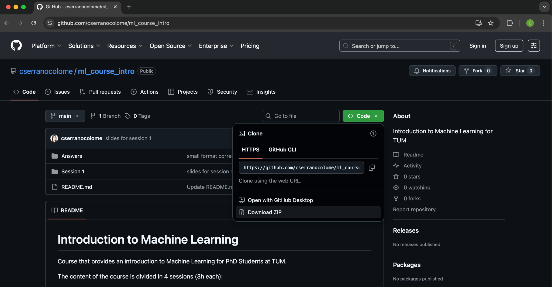
Github
Navigate to https://github.com/cserranocolome/ml_course_intro
Download the materials for the session

Slide 7
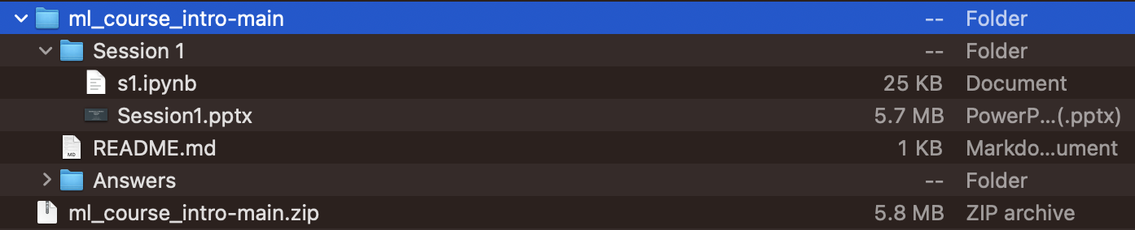
Github
Unzip the folder and you will find the slides and jupyter notebook for the session

Slide 8
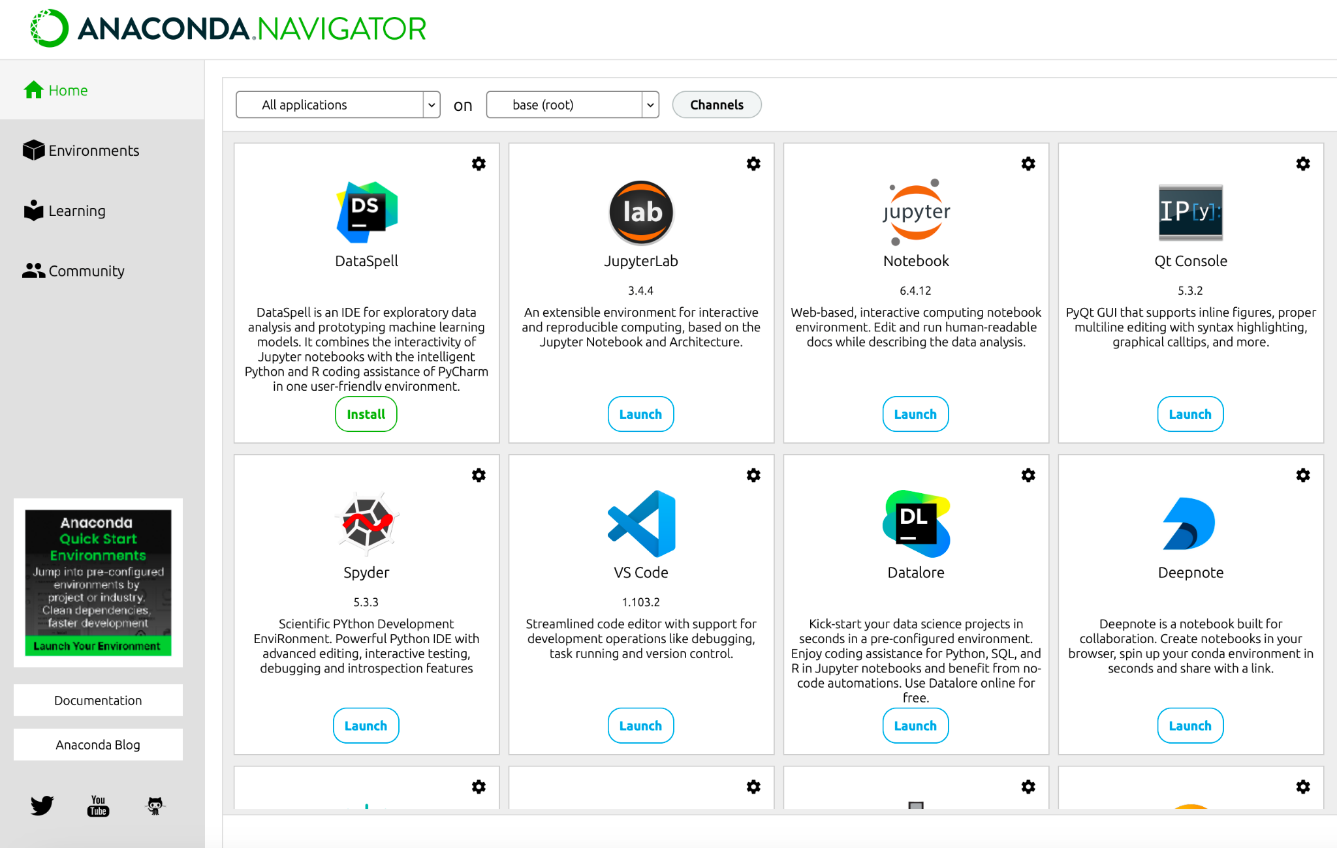
Anaconda Navigator
Start Anaconda Navigator and click on Launch under the jupyter notebook tool

Slide 9
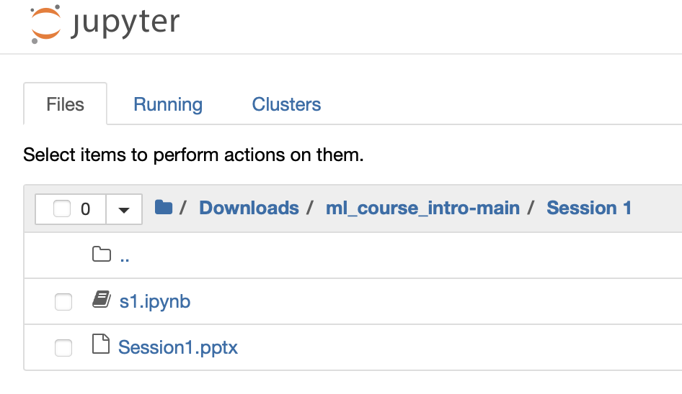
Jupyter Notebook
Navigate to the course directory that you just downloaded and click on s1.ipynb

Slide 10
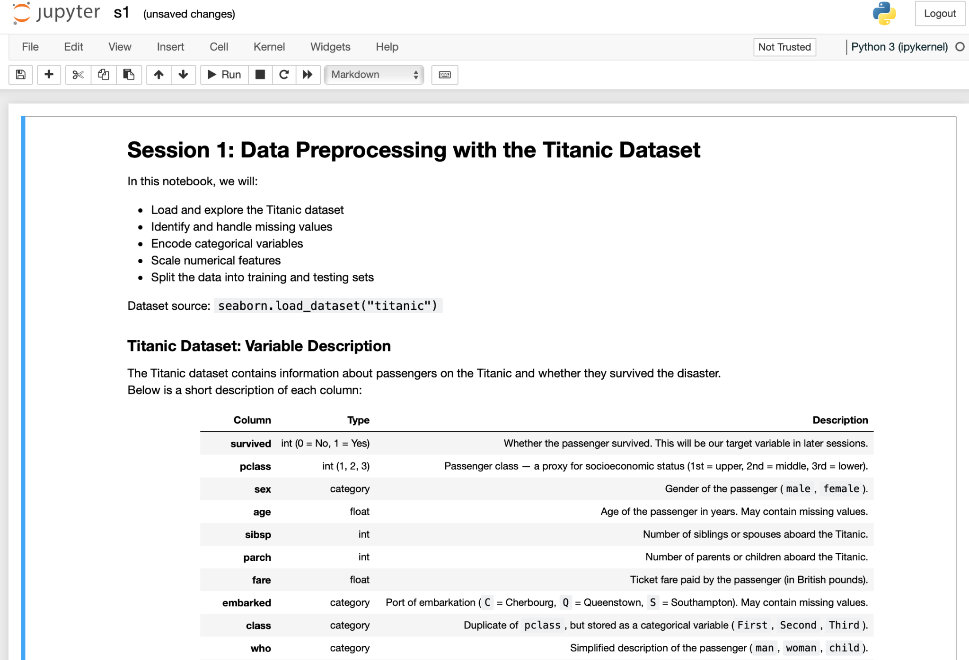
Everything is set for the session!

Slide 11
Today's session outlook
What is Machine Learning (ML)? And why ML?
Types of ML
ML Workflow
Data handling and preprocessing
Handling missing values
Encoding categorical variables
Feature scaling & normalization
Splitting data into training/test sets

Slide 12
What is Machine Learning?
Definition: “A computer program is said to learn from experience E with respect to some class of tasks T and performance measure P if its performance at tasks in T improves with experience E.” (Tom Mitchell, 1997)
Simpler version: “ML is about teaching computers to find patterns in data and make predictions without being explicitly programmed.”
Notes:
Stress the idea of experience → computers improve performance by seeing data.
Use analogy: Just like humans learn by experience (e.g. recognizing cats after seeing many examples).
Clarify: ML ≠ magic → it’s statistics + computation + data.

Slide 13
ML vs Statistics vs AI
AI: Broad field aiming to build “intelligent” machines.
Machine Learning: A subfield of AI, focused on algorithms that learn patterns from data.
Statistics: Foundation for ML; focuses on inference and understanding relationships.
AI = the big picture, ML = practical methods, Statistics = theoretical roots

Slide 14
Why Machine Learning?
Automate tasks (classification, detection, prediction).
Extract patterns from complex/high-dimensional data.
Handle large datasets that traditional methods struggle with.
Cross-disciplinary applications:
Bioinformatics: gene expression clustering.
Physics: predicting material properties.
Social Sciences: text classification for surveys.
Engineering: fault detection in machines.
Notes:
Make it relatable: Ask audience “Who here is working with large datasets?”
Connect to their reality: ML can save time & reveal hidden structure.

Slide 15
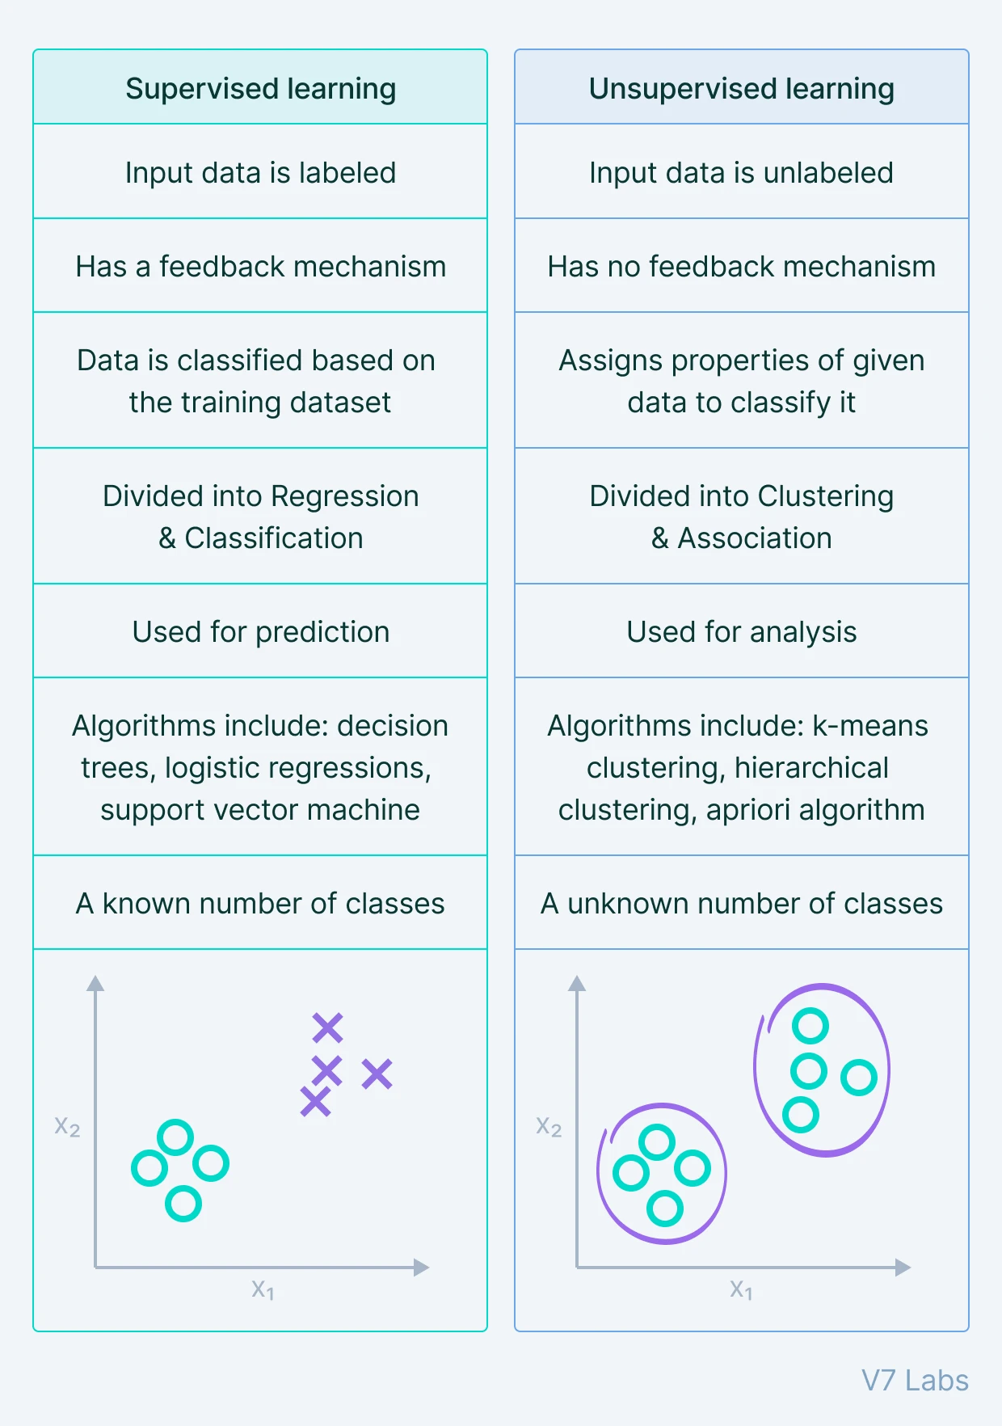
Types of Machine Learning
Supervised Learning:
Data has input (features) and output (labels).
Examples: Predict house prices, classify tumor as benign/malignant.
Unsupervised Learning:
No labels, only data.
Examples: Cluster customers, reduce dimensionality with PCA.
Notes:
“Now you might wonder — where do deep neural networks fit in?”

Slide 16
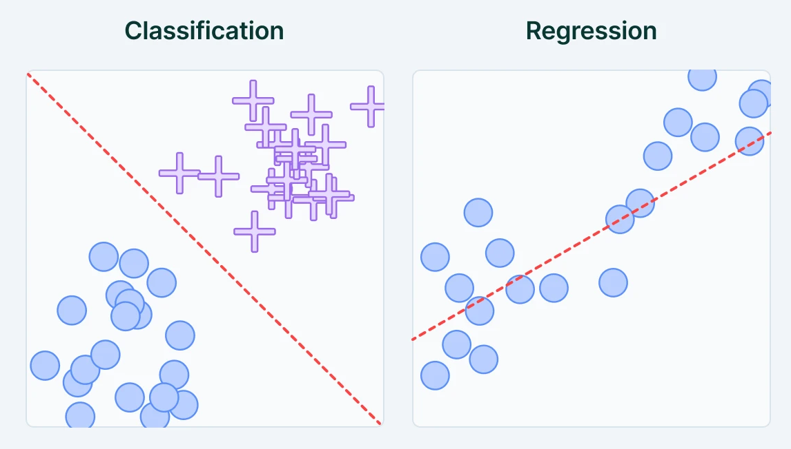
Types of Machine Learning
Dimensionality reduction and Clustering
Source: https://www.v7labs.com/blog/supervised-vs-unsupervised-learning
Notes:
“Now you might wonder — where do deep neural networks fit in?”

Slide 17
Classical ML vs Deep Learning
Classical ML
Relies on engineered features (manual preprocessing, domain expertise).
Algorithms: linear/logistic regression, decision trees, SVMs, k-means, etc.
Works well with structured/tabular data (Excel-like datasets, experiments, surveys).
Deep Learning
Uses neural networks with many layers to learn features automatically.
Particularly powerful for unstructured data (images, audio, text).
Requires large datasets + GPU computation.
Notes:
Emphasize: In this course, focus will be on classical ML because:
Easier to learn foundations
Works well on smaller scientific datasets (most PhD research contexts)
The concepts transfer to deep learning later

Slide 18

The ML Workflow
Workflow is iterative, not linear.
Source: https://medium.com/@mudasserch1/5-core-steps-to-understand-machine-learning-workflow-a-guide-for-beginners-737040850d9b
Notes:
ML isn’t “plug data, get results” — it requires cycles of cleaning, testing, refining.

Slide 19
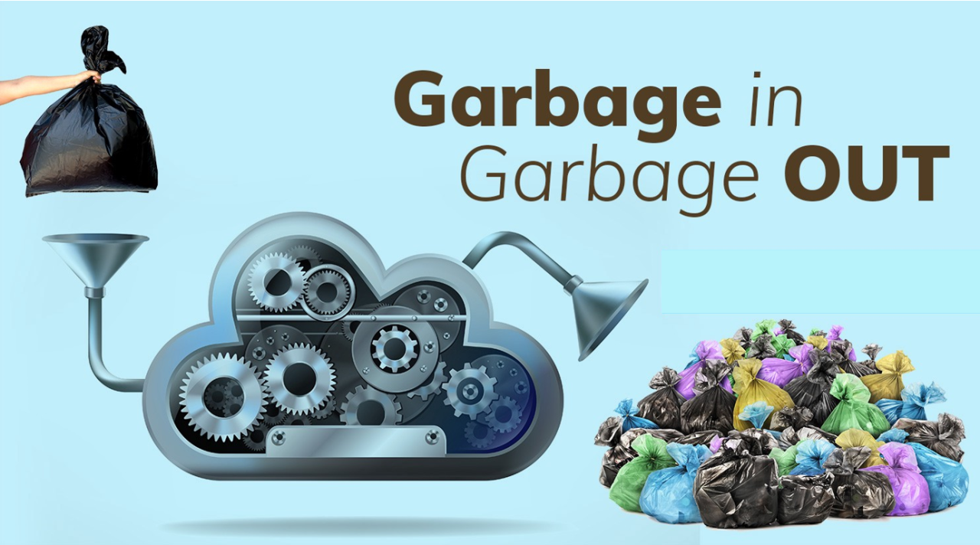
The Role of Data in ML
Quantity of data is very important to train machine learning models.
Quality is, though, even more important.
Potential Issues: noisy data, biased data, missing values
“Garbage in, garbage out” principle
Source: https://www.linkedin.com/pulse/garbage-out-chanthoeun-chiv/
Notes:
Encourage students to reflect: “Is my dataset representative of what I want to study?”

Slide 20
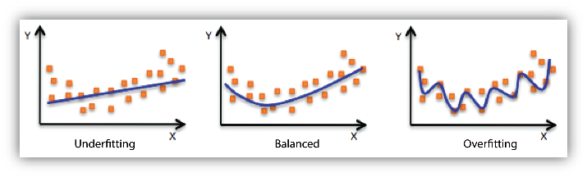
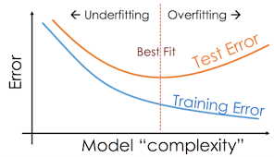
Common Pitfalls
Overfitting (model too complex, memorizes data)
Underfitting (model too simple, misses patterns)
Data leakage (test info leaking into training)
Bias in datasets → biased predictions
Source: https://docs.aws.amazon.com/machine-learning/latest/dg/model-fit-underfitting-vs-overfitting.html and https://vitalflux.com/overfitting-underfitting-concepts-interview-questions/
Notes:
Encourage students to reflect: “Is my dataset representative of what I want to study?”

Slide 21
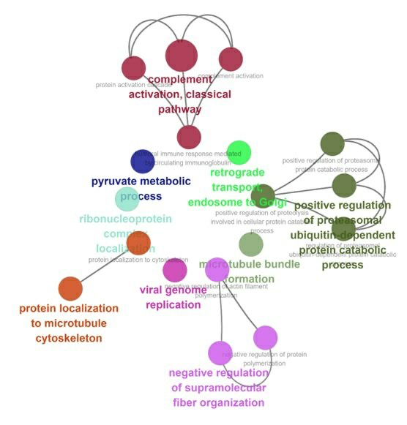
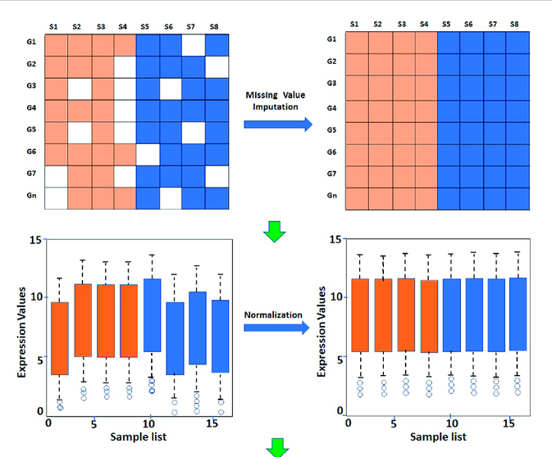
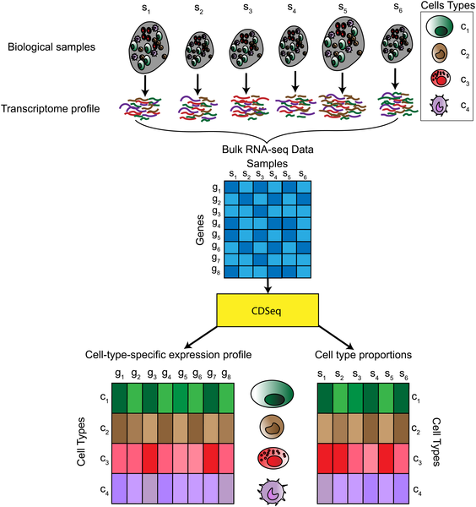
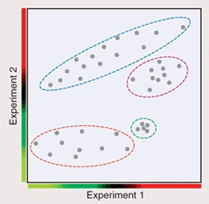
How can you use ML in your research?
Biological validation
Example with gene expression data
Data preprocessing
Data collection
Model

Slide 22
Break

Slide 23
Python for Machine Learning
Why python?
Open-source, free, and easy to learn
Huge community and vast ecosystem of scientific libraries
Excellent for reproducibility and research workflows (Jupyter, GitHub, etc.)
Bridges statistics, data visualization, and machine learning in one environment

Slide 24
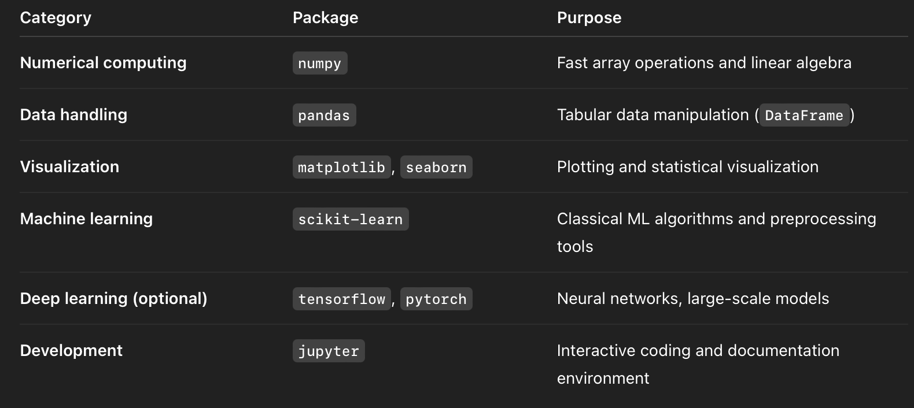
Core Packages in Data Science and ML

Slide 25
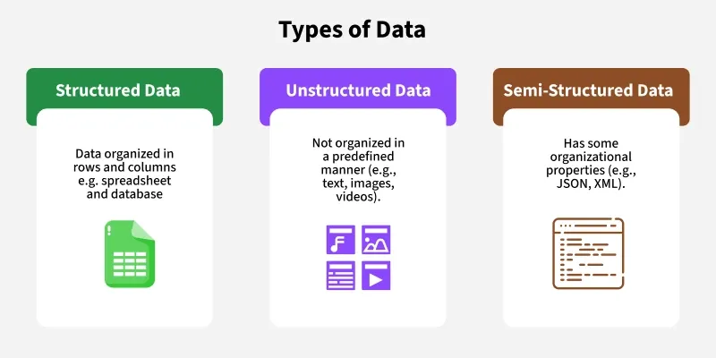
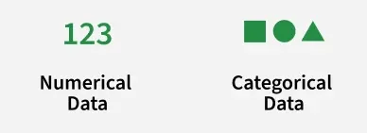
Data Handling and Preprocessing
Source: https://www.geeksforgeeks.org/machine-learning/ml-introduction-data-machine-learning/

Slide 26
Preprocessing steps
Handling missing values
Encoding categorical variables
Feature scaling & normalization
Splitting data into training/test sets

Slide 27

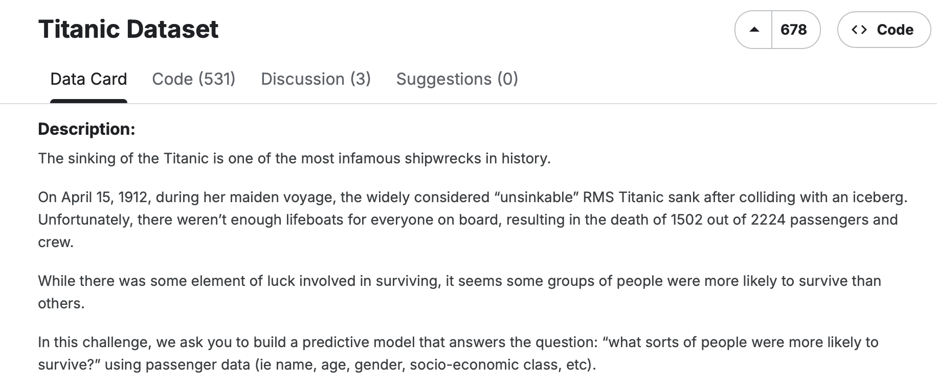
Titanic Dataset

Slide 28
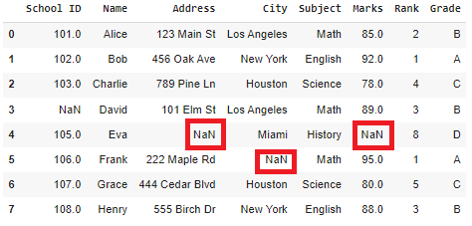
Preprocessing steps
Handling missing values
Encoding categorical variables
Feature scaling & normalization
Splitting data into training/test sets
Drop rows/columns (risky)
df.drop_na()
Imputation (mean, median, mode…)
df['Marks'].fillna(df['Marks'].mean())

Slide 29
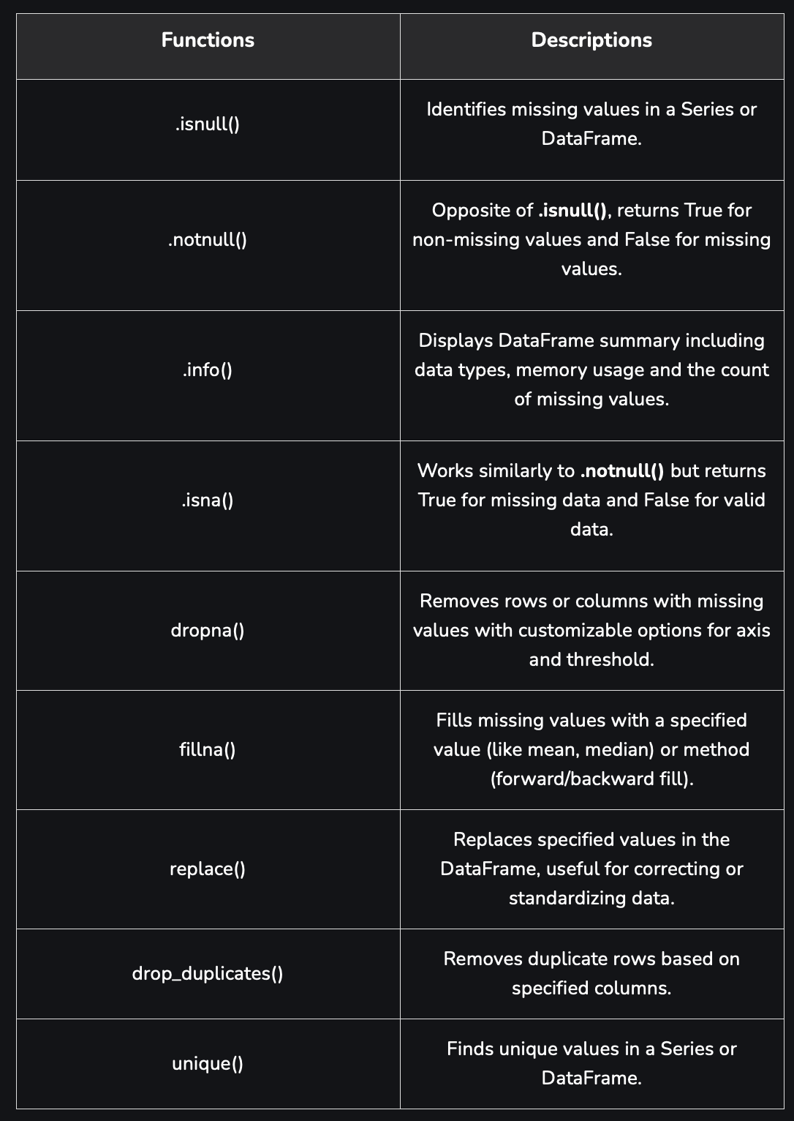
Preprocessing steps
Handling missing values
Encoding categorical variables
Feature scaling & normalization
Splitting data into training/test sets

Slide 30
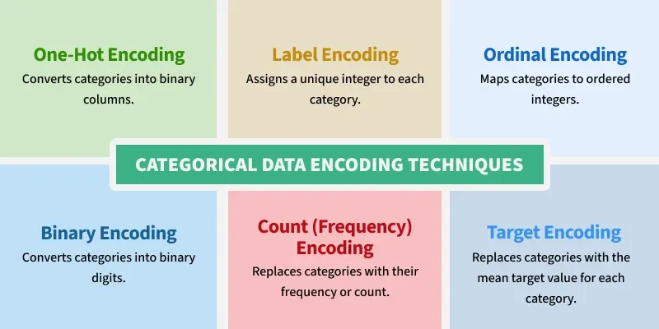
Preprocessing steps
Handling missing values
Encoding categorical variables
Feature scaling & normalization
Splitting data into training/test sets

Slide 31
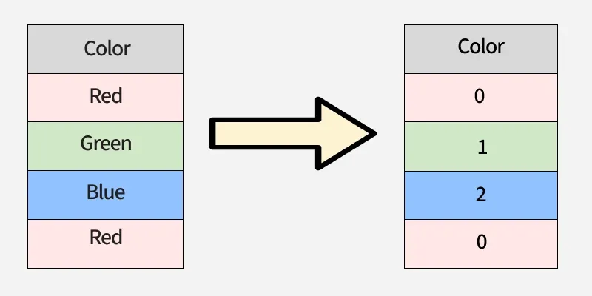
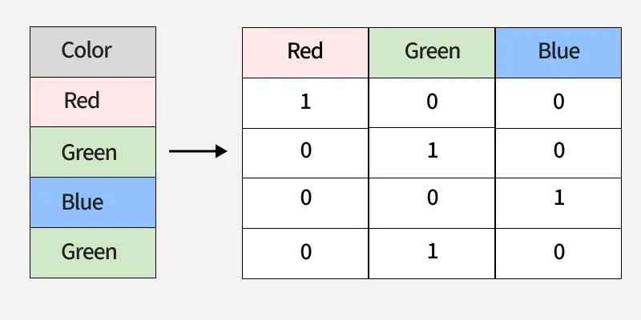
Preprocessing steps
Categorical
Handling missing values
Encoding categorical variables
Feature scaling & normalization
Splitting data into training/test sets
Label Encoding
from sklearn.preprocessing
le = LabelEncoder()
le.fit_transform(data)
2. One-hot Encoding
pd.get_dummies(df['Color'])

Slide 32
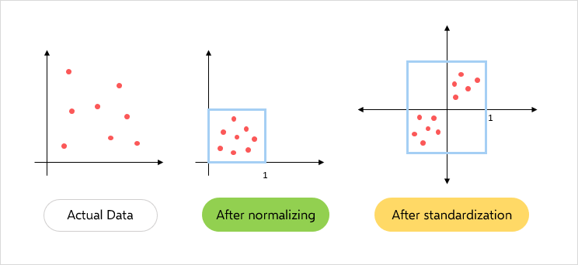
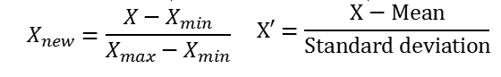
Preprocessing steps
Handling missing values
Encoding categorical variables
Feature scaling & normalization
Splitting data into training/test sets
Normalization
scaler = MinMaxScaler()
normalize = scaler.fit(data)
scaled_data = scale.transform(data)
Standardization
scaler = StandardScaler()
scale = scaler.fit(data)
scaled_data = scale.transform(data)

Slide 33
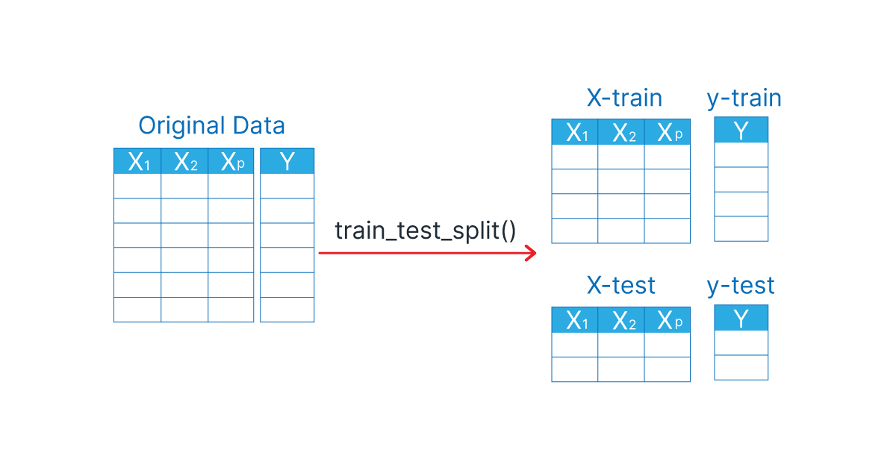
Preprocessing steps
Handling missing values
Encoding categorical variables
Feature scaling & normalization
Splitting data into training/test sets
sklearn split function
X_train, X_test, y_train, y_test = train_test_split(
X, y, test_size=0.05, random_state=0)

Slide 34
Hands On

Slide 35
Additional resources
Missing values
https://www.geeksforgeeks.org/machine-learning/ml-handling-missing-values/
Encoding categorical variables
https://www.geeksforgeeks.org/machine-learning/categorical-data-encoding-techniques-in-machine-learning/
Feature scaling & normalization
https://www.geeksforgeeks.org/data-analysis/normalization-and-scaling/
https://www.geeksforgeeks.org/machine-learning/data-pre-processing-wit-sklearn-using-standard-and-minmax-scaler/
Splitting data into training/test sets
https://www.geeksforgeeks.org/machine-learning/how-to-split-a-dataset-into-train-and-test-sets-using-python/

